Slide 1
Congestion

Slide 2
Congestion
The presence of congestion means that the load is (temporarily) greater than the resources (in a part of the network) can handle.
When number of packets dumped into subnet is more than its carrying capacity.
When too many packets are in the subnet performance degrades
Network congestion is the situation in which an increase in data transmissions results in a proportionately smaller increase, or even a reduction, in throughput.
Network congestion in data networking and queueing theory is the reduced quality of service that occurs when a network node is carrying more data than it can handle.
Congestion results from applications sending more data than the network devices (e.g., routers and switches) can accommodate, thus causing the buffers on such devices to fill up and possibly overflow.

Slide 3
Causes of Congestion – 1/3
Memory
Example - Packets arriving in 3 lines and all need same output line→ queue will be made→ if insufficient memory to hold packets → packets lost
If increase memory → problem worsens
Since, packets time out leading to retransmission → increase in load

Slide 4
Causes of Congestion – 2/3
2) Slow Processor
Line capacity is good but processing is slow → queues build up

Slide 5
Causes of Congestion – 3/3
3) Low bandwidth
Upgrading part and not all simply shifts the bottle neck elsewhere
If bandwidth is high, processor is low → congestion
If bandwidth is low, processor is high → congestion

Slide 6
Solutions
Increase resources, or
Decrease load
These solutions are usually applied on different time scales to either prevent congestion or react to it once it has occurred.

Slide 7
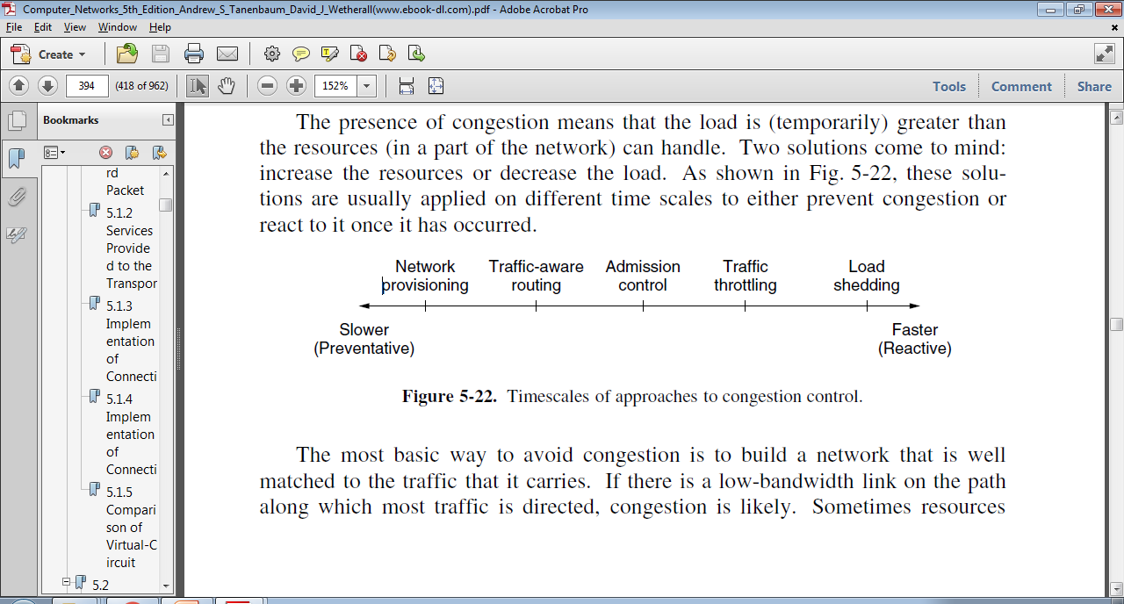

Slide 8
General Principles of Congestion Control
Regards to current state of the network
Congestion Control
Open Loop
Closed Loop
Preventive Policy
Corrective Policy
Solve the problem by good design
No mid course corrections
Tools
Acceptance of new traffic?
Rejection of packets?
Schedules ?
3 parts
Monitor
Pass
Adjust
No Regard to current state of the network

Slide 9
Closed loop solutions

Slide 10
Monitor
Monitor the system to detect when and where congestion occurs.
Metrics used –
% of all packets discarded for lack of buffer space
Average queue length
Number of packets that time out and retransmitted etc.
Higher the metric value → growing congestion

Slide 11
Pass information
Inform to places where action can be taken
Pass the information of congestion from the point of detection to the point of correction
Feedback Loop
Ways
Packet –
Router that detects congestion sends packets to traffic source(s) announcing problem.
Leads to further congestion
Bit/Field –
a field is reserved in packet to be set by router when congestion crosses threshold. Router sets this field in all outgoing packets to warn
Probe packet –
Hosts and routers periodically send these to explicitly ask about congestion
This information can be used to route traffic around problem area

Slide 12
References
https://en.wikipedia.org/wiki/Network_congestion
http://www.linfo.org/congestion.html

